Slide 1
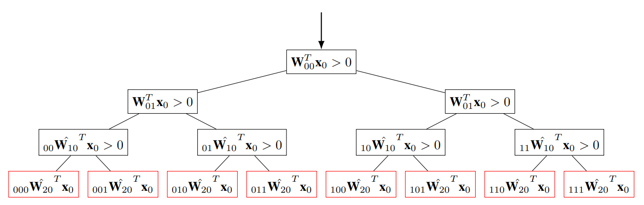










$$_{∅}{\hat{W}}_{0}=W_{0}$$
$${\left( _{∅}{\hat{W}}_{0}x_{0}\right)}_{0}>0$$
$${\left(a_{0}\right)}_{0}=1$$
第0層，0次元
F
T
$${\left(a_{0}\right)}_{1}=0$$
$${\left(a_{0}\right)}_{1}=1$$
第0層，1次元
第1層，0次元
$${\left(a_{1}\right)}_{0}=1$$
$${\left(a_{1}\right)}_{0}=1$$
$$c_{0}=a_{0}=\left(1,1\right)$$
$$c_{1}=a_{1}∥a_{0}=\left(1,0,1\right)$$
$$c_{1}=a_{1}∥a_{0}=\left(1,1,1\right)$$

Slide 2

































$$m_{0}=2$$
$$x_{0}$$
$$x_{1}$$
$$m_{output}=1$$
$$y=NN(x_{0})$$
$$x_{i−1}$$
$$x_{i}=σ\left(W_{i−1}^{T}x_{i−1}\right)$$
$$W_{i−1}^{T}x_{i−1}$$
$$σ$$
$$W_{0}$$
$$W_{1}$$
$$m_{input}×m_{0}$$
$$m_{0}×m_{1}$$
$$W_{i−1}$$
$$\left(m_{input}\right)$$
$$\left(m_{0}\right)$$
$$\left(m_{1}\right)$$
$$\left(m_{n−2}\right)$$
$$x_{0}$$
$$x_{1}$$
$$x_{2}$$
$$x_{n−1}$$
$$\left(m_{output}\right)$$
$$y=NN(x_{0})$$
$$⋯$$
$$W_{0}$$
$$W_{1}$$
$$W_{n−2}$$
$$W_{n−1}$$
$$\left(m_{input}×m_{0}\right)$$
$$\left(m_{0}×m_{1}\right)$$
$$\left(m_{n−3}×m_{n−2}\right)$$
$$\left(m_{n−2}×m_{n−1}\right)$$

Slide 3










$$x_{i−1}$$
$$x_{i}=σ\left(W_{i−1}^{T}x_{i−1}\right)$$
$$W_{i−1}^{T}x_{i−1}$$
$$σ$$
$$W_{i−1}$$
$$x_{i−1}$$
$$x_{i}=σ\left(W_{i−1}^{T}x_{i−1}\right)$$
$$W_{i−1}^{T}x_{i−1}$$
$$_{r}x_{i−1}$$
$$σ$$
$$W_{i−1}$$

Slide 4




























$$y^{\left(1\right)}$$
$$y^{\left(2\right)}$$
$$y^{\left(t−1\right)}$$
$$y^{\left(t\right)}$$
$$y$$
$$h^{\left(0\right)}$$
$$h^{\left(1\right)}$$
$$h^{\left(2\right)}$$
$$h^{\left(t−1\right)}$$
$$h^{\left(t\right)}$$
$$h$$
$$⋯$$
$$x^{\left(1\right)}$$
$$x^{\left(2\right)}$$
$$x^{\left(t−1\right)}$$
$$x^{\left(t\right)}$$
$$x$$
$$y^{\left(t\right)}$$
$$W$$
$$V$$
$$V^{T}h^{\left(t\right)}$$
$$h^{\left(t−1\right)}$$
$$W^{T}h^{\left(t\right)}$$
$$h^{\left(t\right)}$$
$$σ$$
$$U$$
$$U^{T}x^{\left(t\right)}$$
$$x^{\left(t\right)}$$

